Slide 1
Travel and Tour Management
CDAC, Acts Project
2200940120019 Ajay Maruti Khade 2200940120064 Digvijay Dilip Sawant
2200940120073 Gaurav Kumar
2200940120059 Dangat Shubham Ulhas
2200940120103 Kritika Shrivastava
Under Guidance of Mr.Vinu josy

Slide 2
SAFARI
Travel and Tour Management
Purpose of “Travel and Tour Management System” is to provide a convenient way for a customer to book a tour.

Slide 3
CONTENTS
01
About Project
02
Technology
03
Data Base
04
Functionalities
05
UI Frames

Slide 4
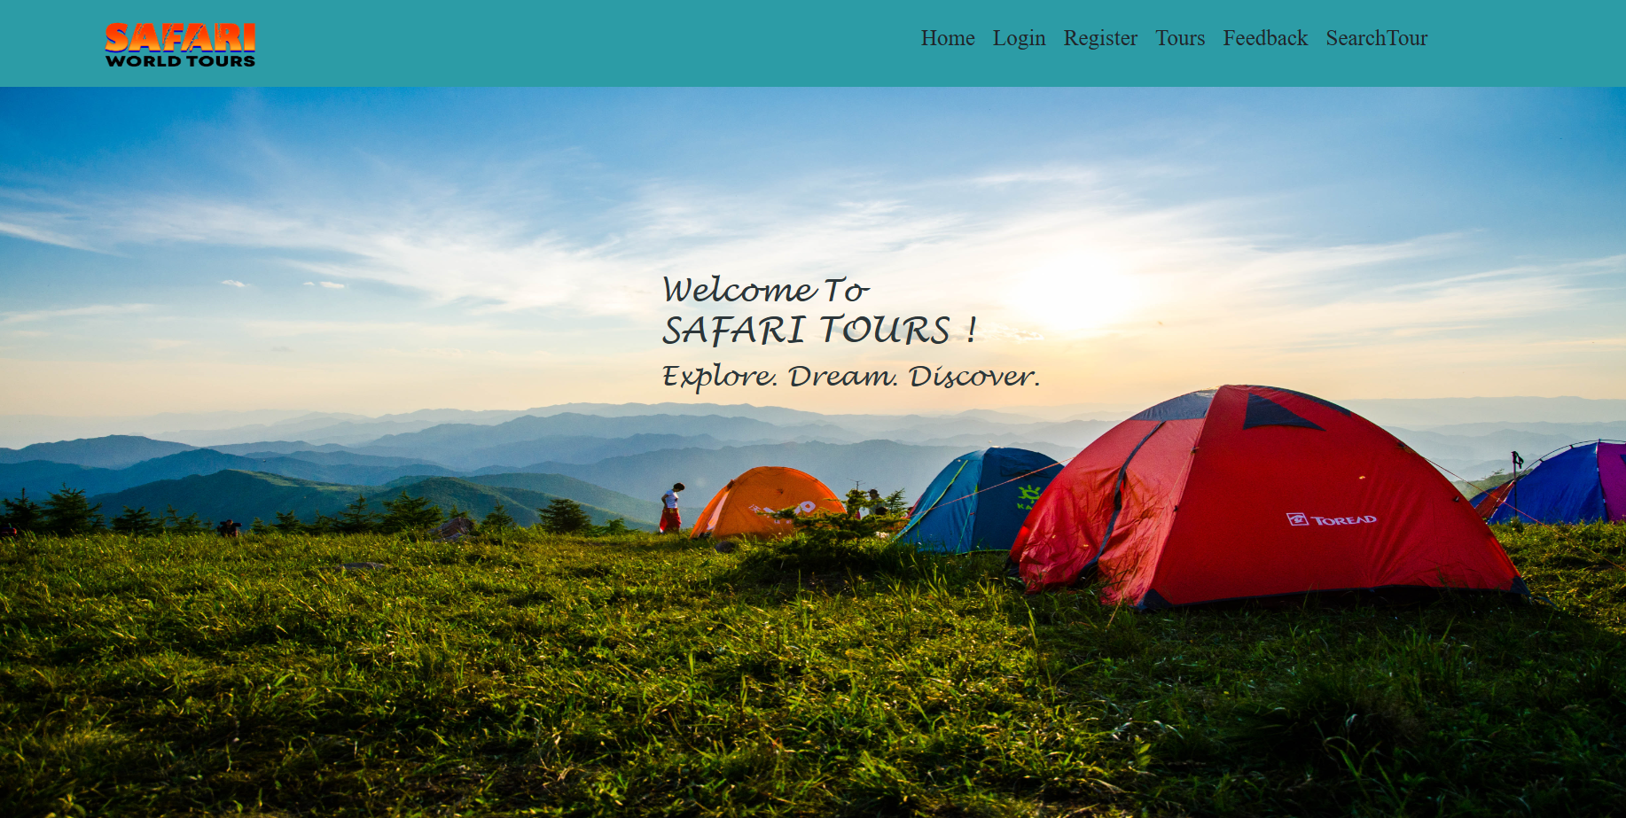
1
About Project
Why Travel and Tourism Management ??
To provide a convenient way for a customer to book a tour.
Internet users are increasing day by day.
“Safari” is to facilitate the offline customer online.
To provide a feasible and smooth travel booking experience.

Slide 5
1
About Project
Multiple
Functionalities
Simple UI
1
2
3
4
Multiple Search
options
Easy To add
More Functionalities

Slide 6



2
Technology Used
SpringBoot For BackEnd
React For FrontEnd
MySql For Database

Slide 7
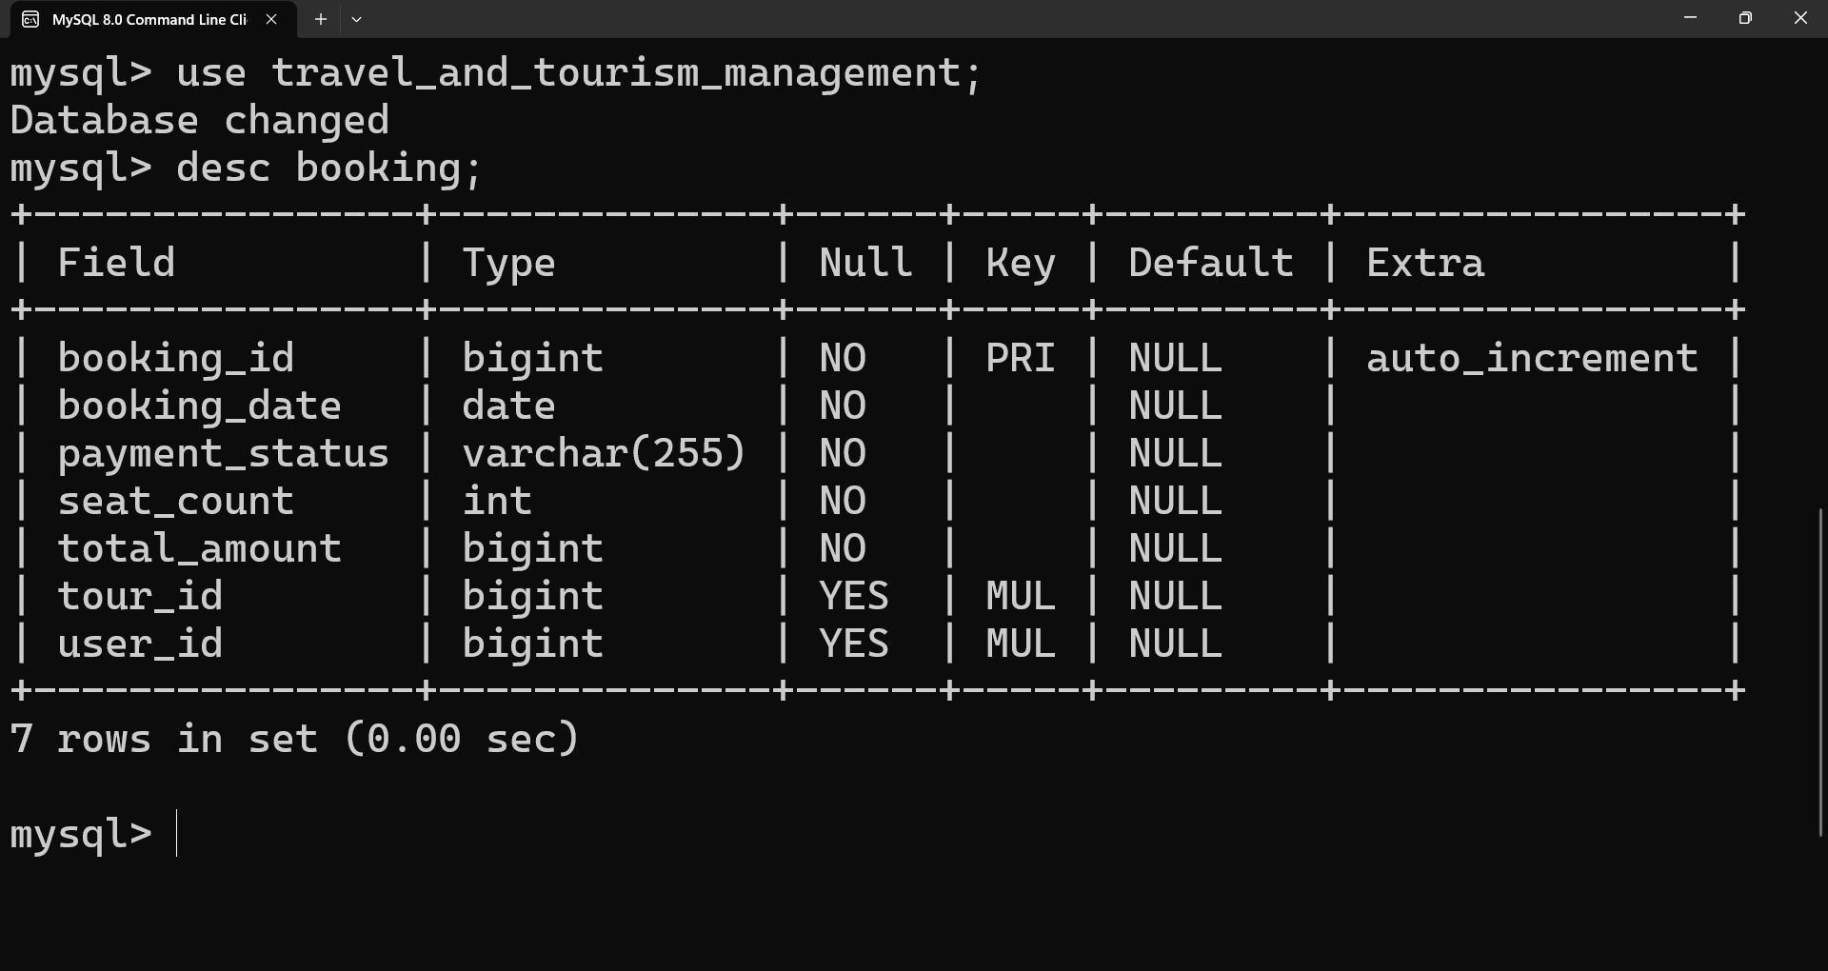
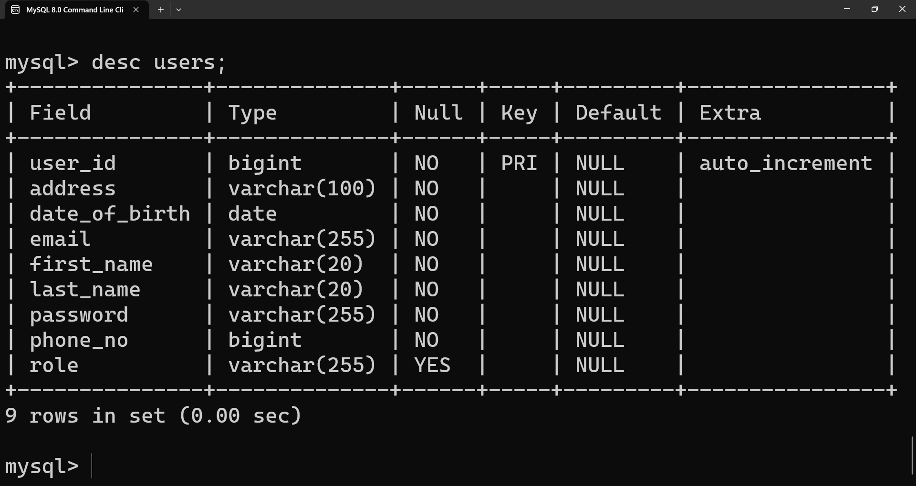
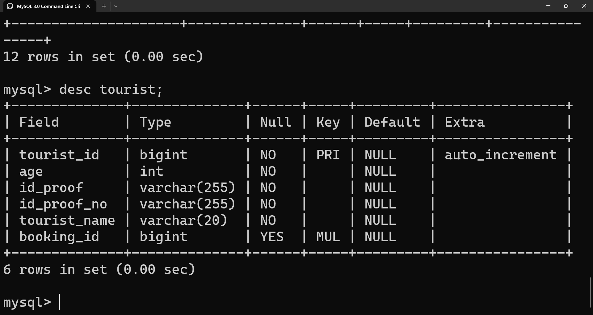
3
DataBase
Booking
User
Tourist

Slide 8
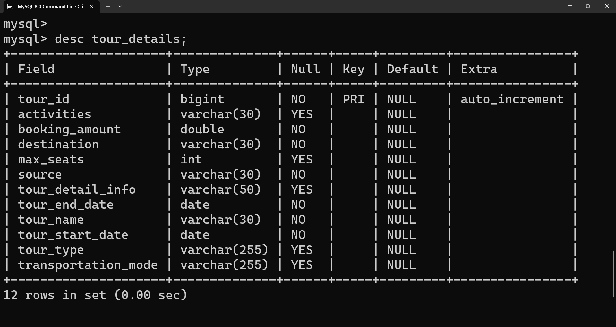
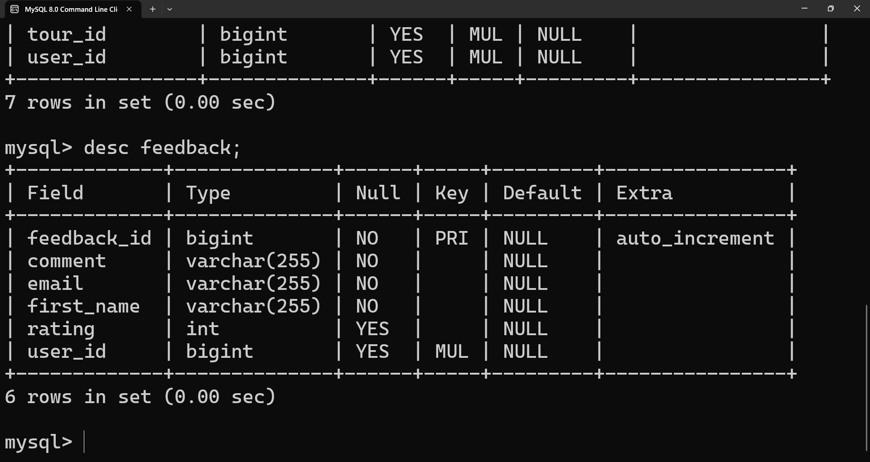
3
DataBase
Tour Details
Feedback

Slide 9
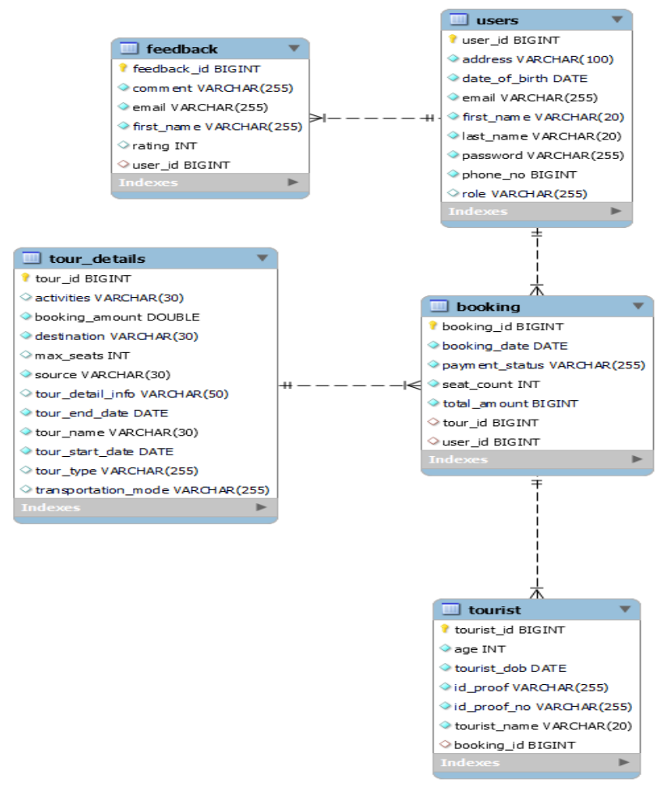
3
DataBase
Entity Relationship Diagram

Slide 10
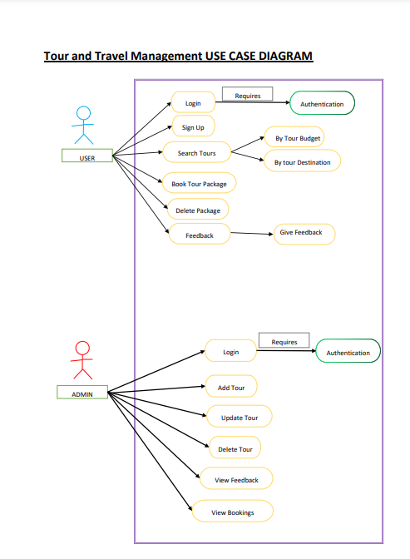
Use Case Diagram

Slide 11


4
Functionalities
Admin
User
Register
Login
Edit Profile
Search Tours
Book Packages
Feedback
Login
View Feedback
Check All Packages
Add Tours
Update Tours
Delete Tours

Slide 12
UI
UI Frames
FrontEnd is Developed with help of React
It’s Fast, Simple, and Easy to Use,
React Components Ease Debugging
Bootstrap make react more simple to use.

Slide 13
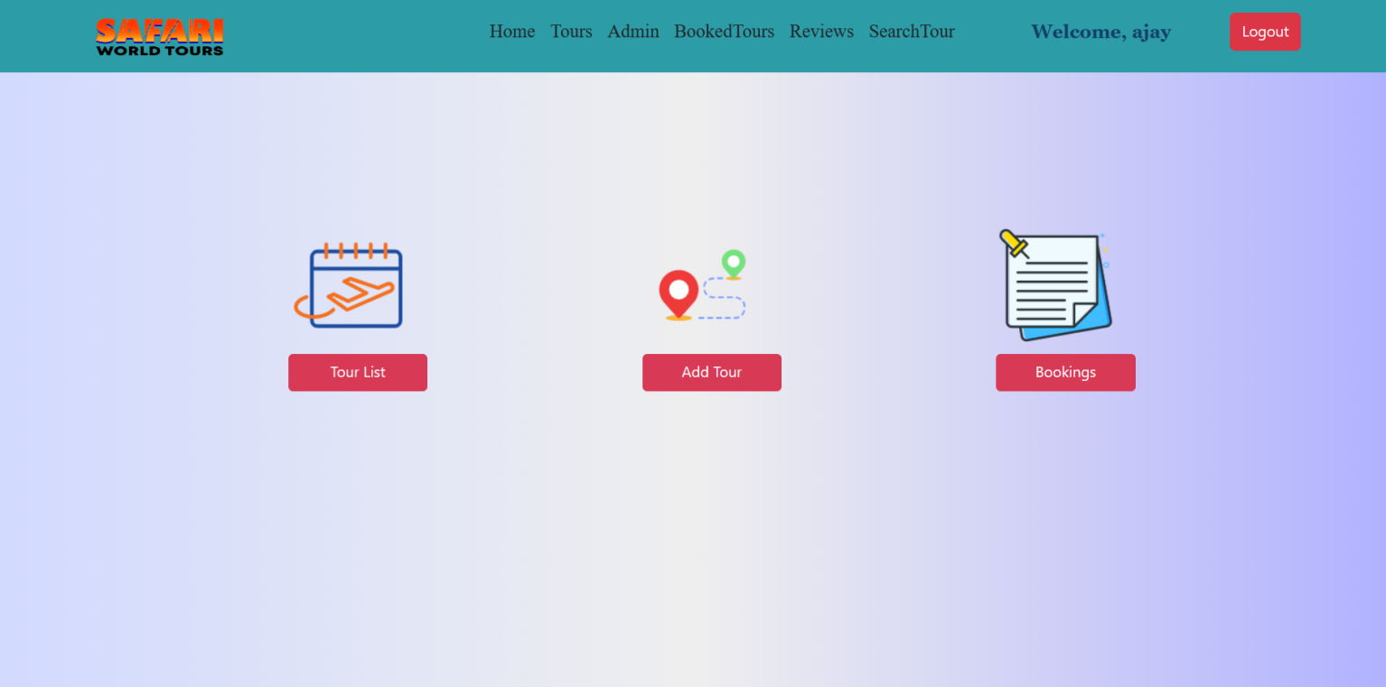
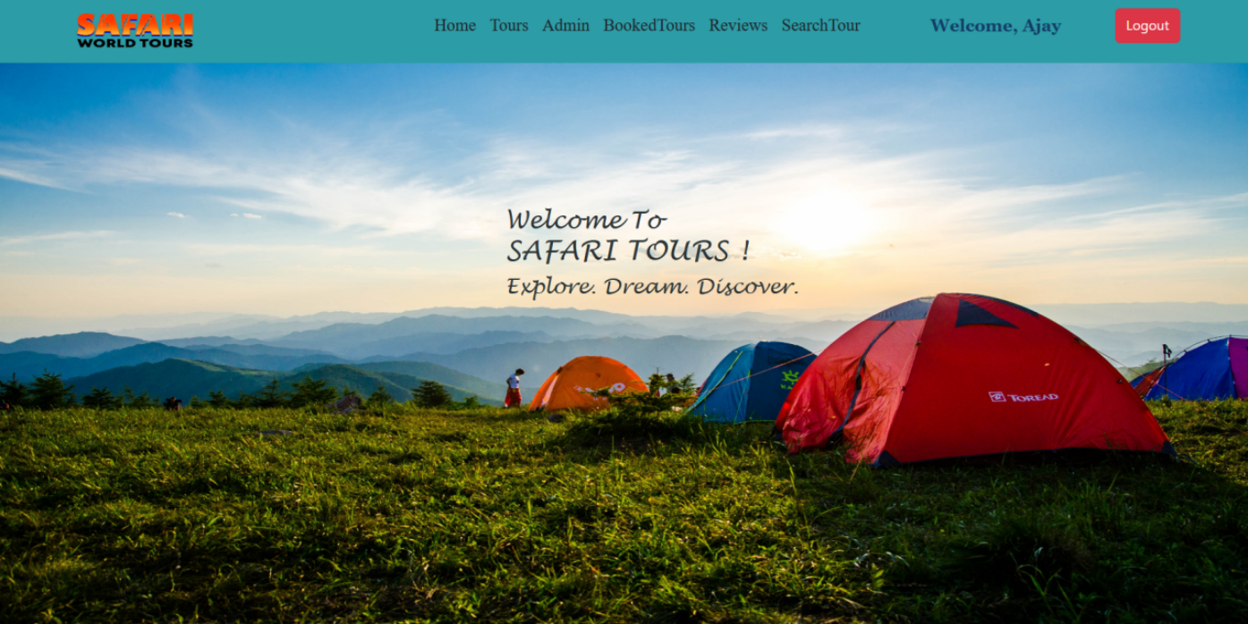
5
UI Frames
Admin UI
Admin UI
Admin Functionalities

Slide 14
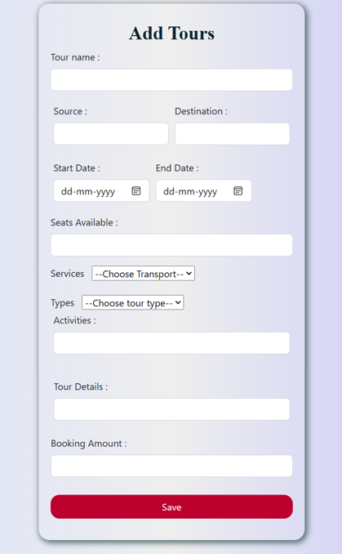
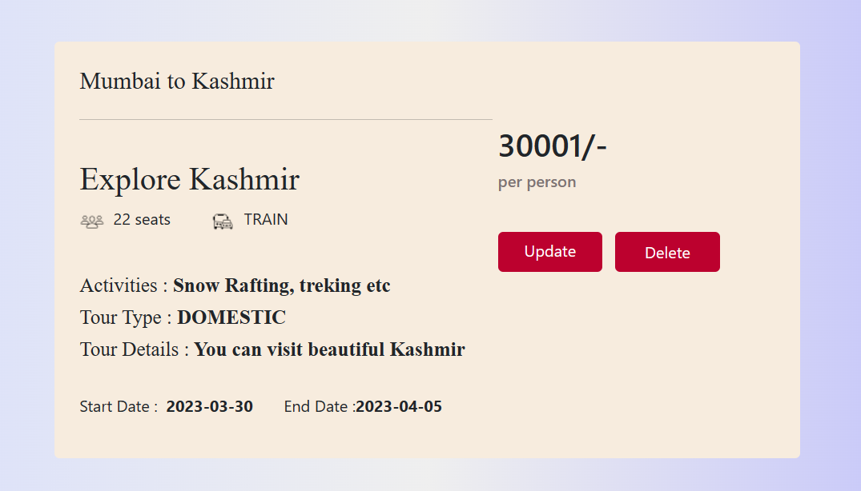
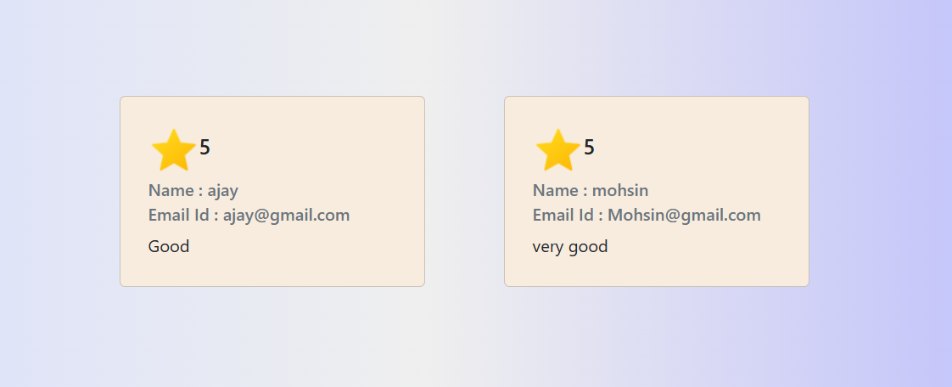
5
UI Frames
Admin UI
View User Feedback
Update/Delete Tour Package
Add Tour

Slide 15
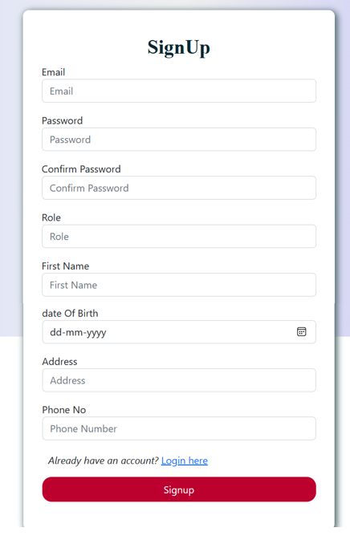
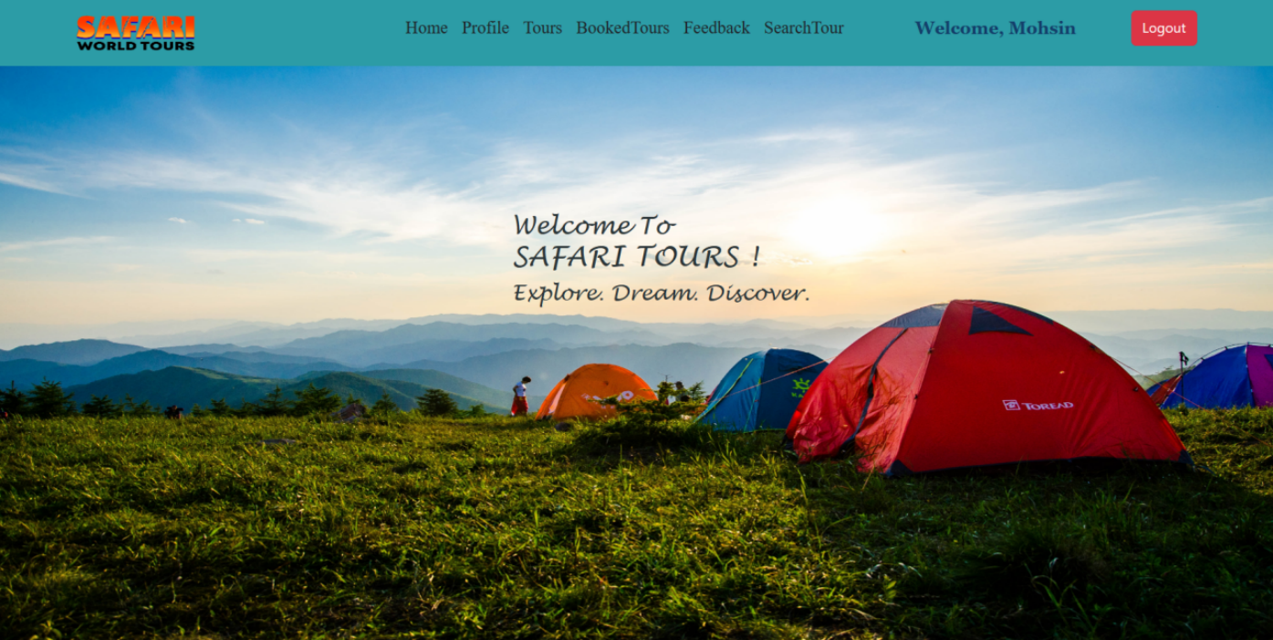
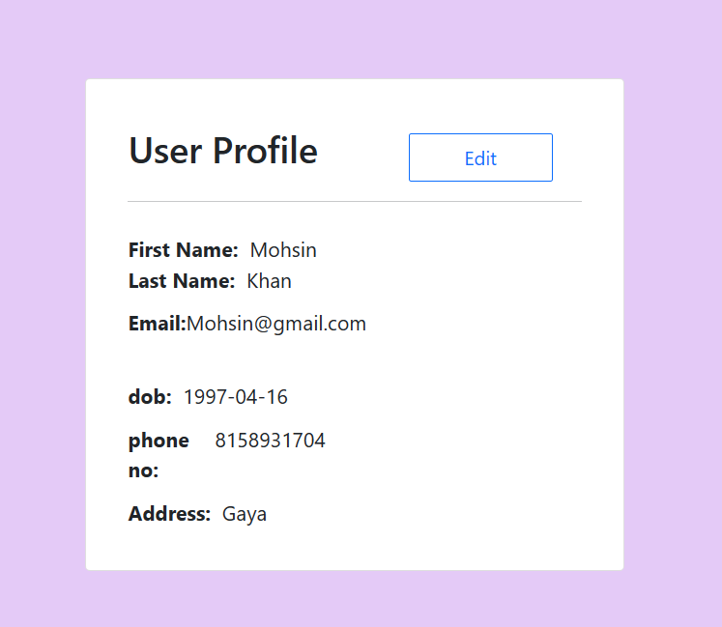
5
UI Frames
User UI
User UI
User Profile
User SignUp

Slide 16
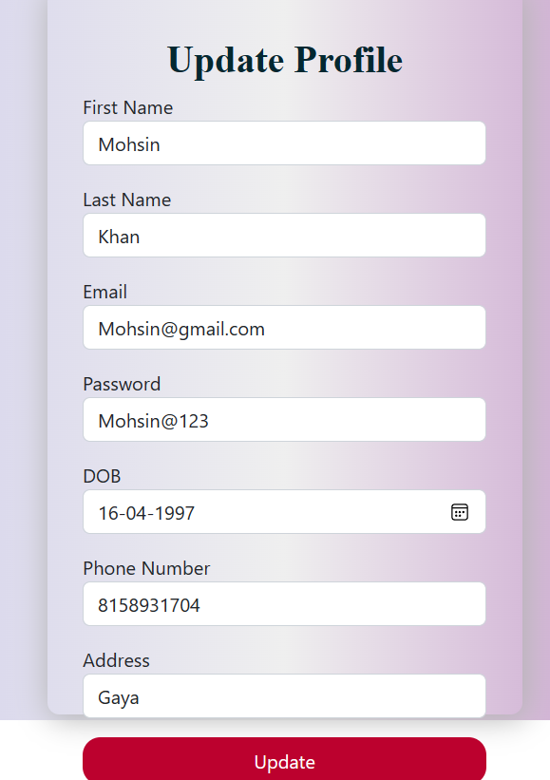
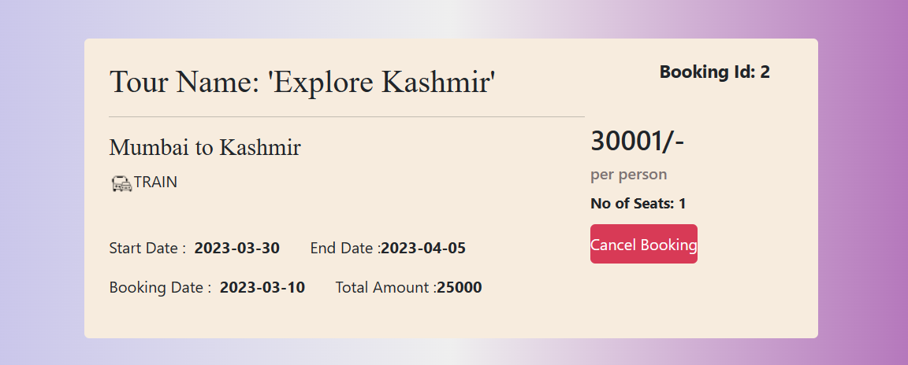
5
UI Frames
User UI
Cancel Booking
Update User Profile

Slide 17
Thank You For Your Time

